Slide 1

Guidelines
Kindly use the given template for submitting your project (Make a copy of the template)
One team is only required to submit one project/ppt.
The ideal size of the presentation should not be more than 10 slides.
You are welcome to add as many POCs and design concepts to support your project.
The project should be feasible and the team members should be capable enough, to come up with the prototype of the same idea, if required.
Solutions must include at least one Google technology.

Slide 2
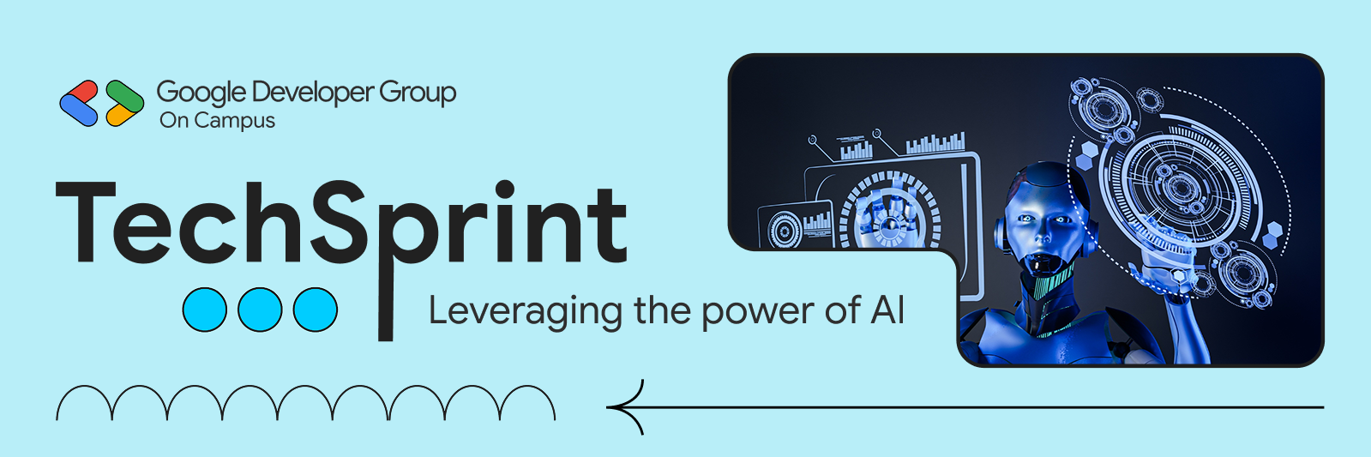
Team Details
Team name: Y000
Team leader name: Sharath Gadhagoni
Problem Statement: AI Education Platform

Slide 3
Brief about your solution and problem statement addressing
Problem Statement:
India currently lacks a unified, district-level digital platform to monitor and improve learning outcomes across schools.
Educational data is fragmented across institutions, teachers lack real-time insights into student performance, and students—especially in regional and rural contexts—do not receive personalized academic support.
This gap makes it difficult for schools, districts, and government authorities to track progress, identify learning gaps, and take timely, data-driven interventions.
Proposed Solution – EduBridge AI
EduBridge AI is a district-scalable, AI-powered education platform that connects students, teachers, principals, and administrators on a single system. It provides:
AI-assisted learning through multilingual, context-aware tutoring
Real-time dashboards for teachers and school leadership
District-level analytics to monitor learning trends and performance
Offline-friendly, web-based access for inclusive reach
The platform enables early intervention, personalized learning, and transparent monitoring, helping governments move from reactive reporting to proactive education governance.

Slide 4
Opportunities:
How is this different from existing ideas?
Existing education platforms work in isolated parts (attendance, exams, or reporting), whereas this solution provides a single, integrated district-level system.
There is no current government platform that continuously monitors all schools in an entire district with real-time insights.
Unlike static data portals, this platform uses AI-driven analytics to identify learning gaps, dropout risks, and performance trends.
Supports multiple stakeholders (District Officers, Block Officers, Principals, Teachers, and Students) on one unified platform.
Focuses on decision support, not just data collection or compliance reporting.
2. How will it be able to solve the problem?
Collects and integrates academic, attendance, and engagement data from all schools across the district.
Uses AI to detect early warning signals such as declining performance or potential dropouts.
Provides real-time dashboards for district and block-level officials to enable faster interventions.
Reduces manual reporting and administrative workload through automated analytics and reports.
Enables evidence-based policy decisions and targeted resource allocation at the district level.

Slide 5
List of features offered by the solution:
District-Wide Coverage: Unified monitoring of all schools across school → block → district levels.
AI-Driven Learning Support: Personalized learning insights and early identification of learning gaps.
Multilingual & Inclusive Access: Regional language support for equitable education delivery.
Role-Based Dashboards: Dedicated access for DEO, BEO, Principals, Teachers, and Students.
Real-Time Analytics: Performance tracking, comparisons, and decision-ready insights.
Continuous Assessment: Automated evaluations with performance trend analysis.
Early Warning System: Alerts for dropout risk, low attendance, and poor performance.
Content & Curriculum Management: Centralized, policy-aligned learning resources.
Offline & Low-Connectivity Support: Designed for rural and low-internet environments.
Secure & Scalable Architecture: Data security, audit logs, and scalability from district to state..

Slide 6
Google Technologies Used in EduBridge AI
Core AI & Cloud Technologies
Google Gemini AI – AI-powered learning assistance, multilingual support, and content generation
Google Cloud Platform (GCP) – Scalable, secure cloud infrastructure for district-wide deployment
Progressive Web App (PWA) – Offline access and low-bandwidth support
Security & Authentication
Secure API Management – Backend-managed AI services with access control
OAuth 2.0 Ready – Secure authentication for teachers and students
Analytics & Intelligence
AI-Based Insights – Learning gap detection, performance trends, and early warning alerts
Real-Time Dashboards – School, block, and district-level visibility
Reliability & Continuity
Multi-Level AI Fallback System – Ensures uninterrupted service availabilit

Slide 7
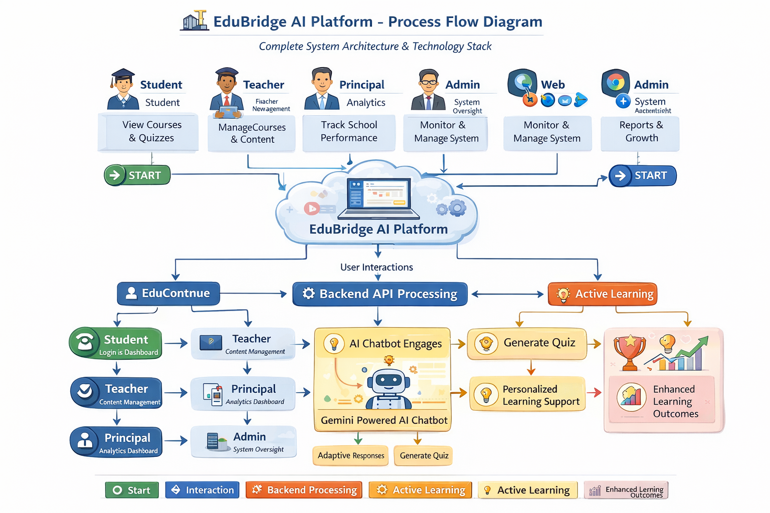
Process flow diagram or Use-case diagram

Slide 8
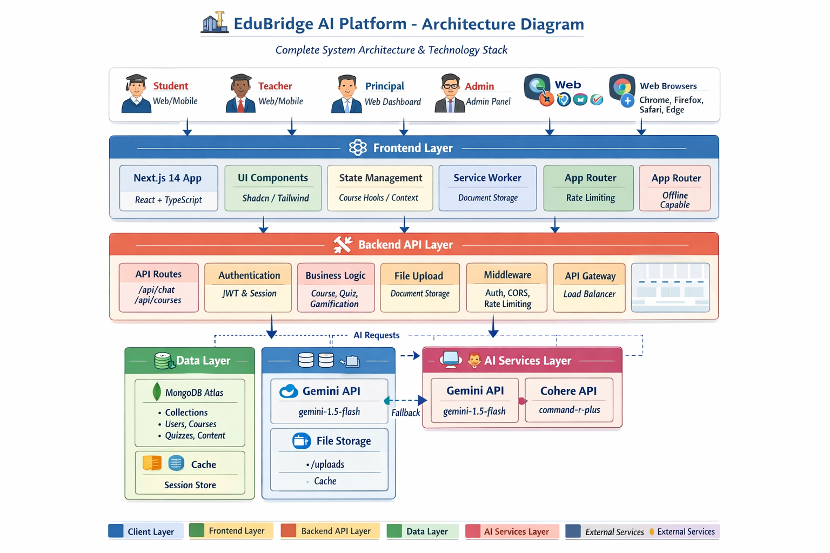
Architecture diagram of the proposed solution

Slide 9
Sample credentials
Email: superadmin@edubridge.com
Password: superadmin123
Principals
robert.anderson@greenvalley.edu / principal123
patricia.martinez@sunriseschool.edu / principal123
jennifer.wilson@oakwoodacademy.edu / principal123
Teachers
Password for all teachers: teacher123
Example: sarah.johnson@greenvalley.edu / teacher123
(Check the database for specific teacher emails)
Students
Password for all students: student123
Example: alex.thompson.9th.A@student.edu / student123
(Check the database for specific student emails)
Default Admin (from older seed)
Email: admin@edubridge.com
Password: admin123

Slide 10
Provide links to your:
GitHub Public Repository: https://github.com/sharath2004-tech/edu-bridge-ai-platform-bharath-hackathon
Demo Video Link (3 Minutes): https://drive.google.com/file/d/114TJ7_aQMKoFGYFe7X9BaQHjk0h2eocI/view
MVP Link: https://edu-bridge-ai-platform-bharath-hack.vercel.app/

Slide 11
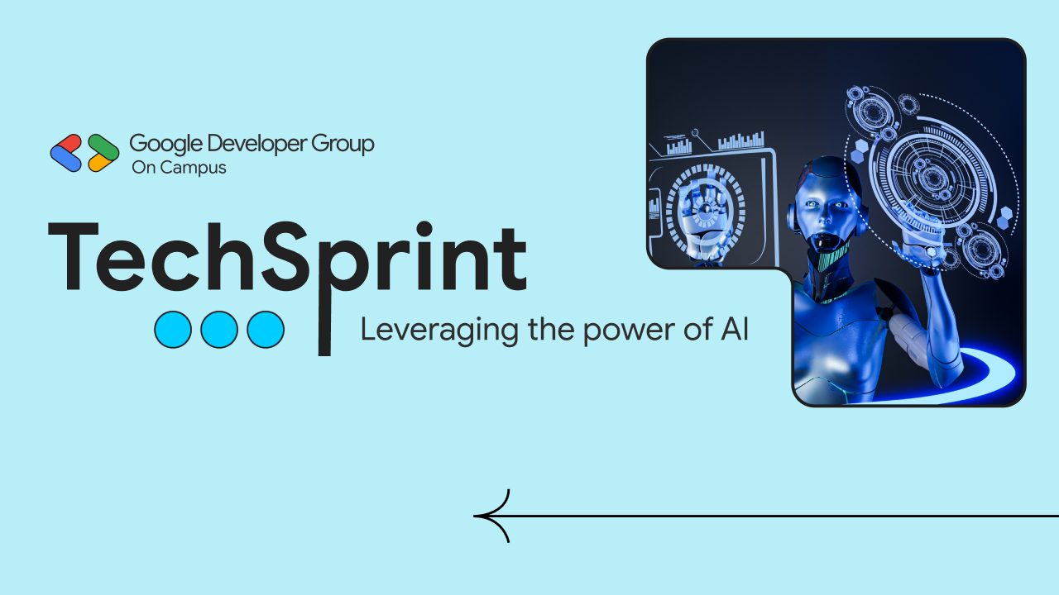
Thank you!

